Slide 1
Kathleen M. Rehl, Ph.D., CFP®, CeFT® Emeritus
Forl Professional Use Only. Not For Use With Consumers.

Slide 2
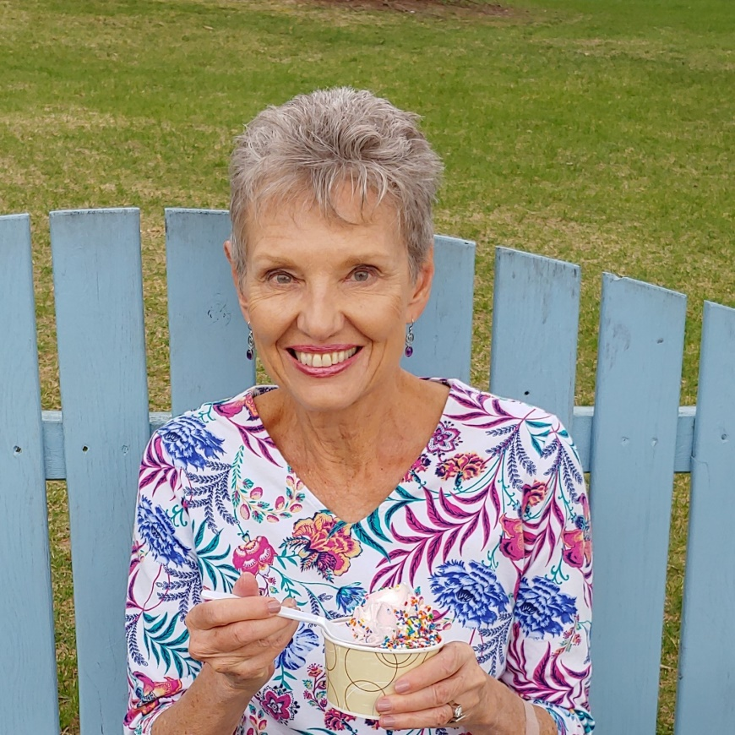
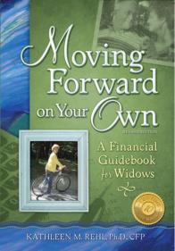
About Kathleen M. Rehl, Ph.D., CFP®, CeFT® Emeritus
Dr. Kathleen Rehl wrote the multi-award-winning book, Moving Forward on Your Own: A Financial Guidebook for Widows after the death of her late husband. Over 75,000 copies of this book are now in circulation.
She owned Rehl Financial Advisors for almost 18 years before retiring to a six-year encore career empowering widows and their advisors—through her speaking, writing, mentoring, and research about widows. Her work has been featured in more than 160 articles published by the New York Times, Wall Street Journal, Kiplinger’s, CNBC, USA Today, Journal of Financial Planning, Journal of Financial Service Professionals, and many others.
Now “reFired,” Kathleen assists selected nonprofits and organizations that help widows. She also writes legacy stories and poems, plus encourages others to leave a legacy of love.
For Professional Use Only. Not For Use With Consumers.

Slide 3

For Professional Use Only. Not For Use With Consumers.

Slide 4
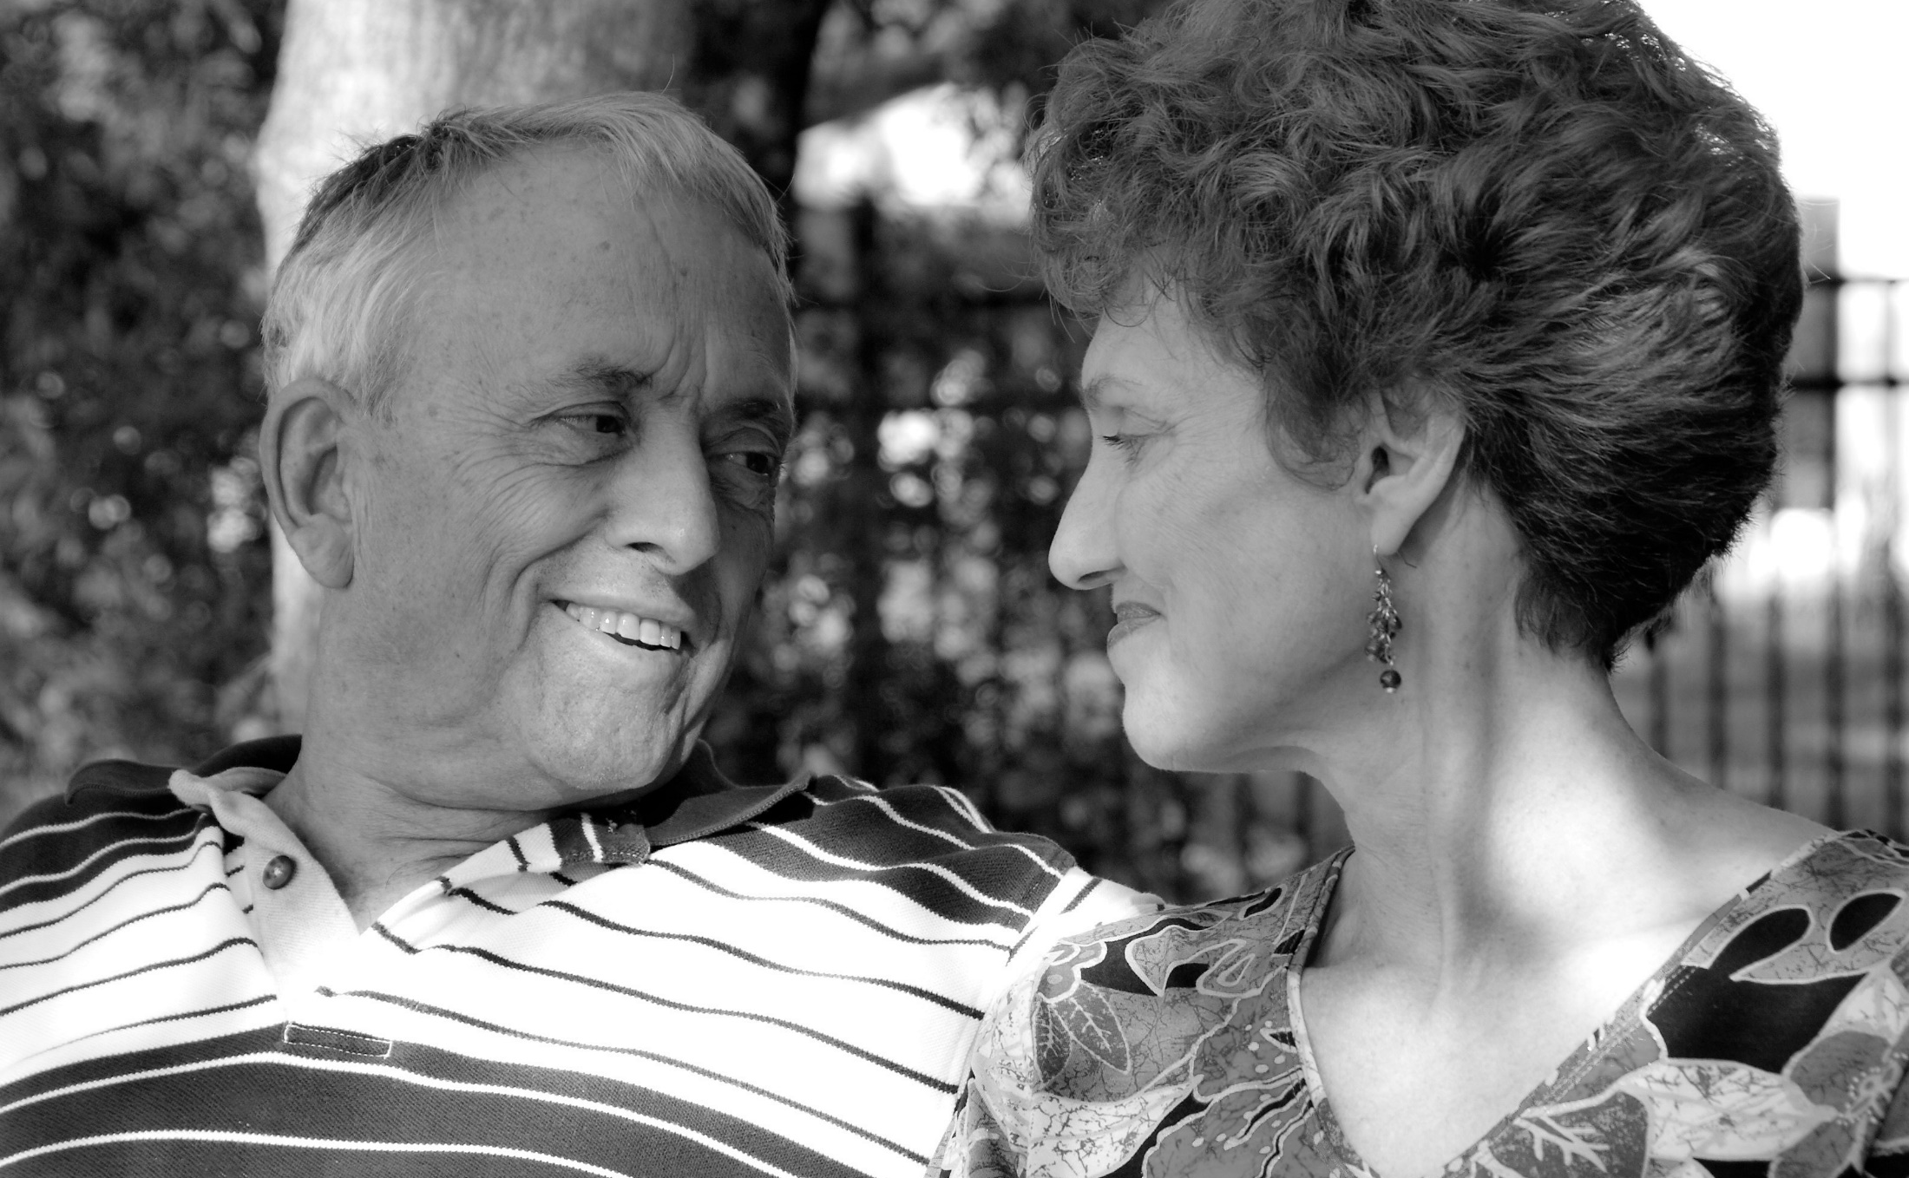

Slide 5

For Professional Use Only. Not For Use With Consumers.
For Financial Professional Use Only. Not For Use With Consumers.

Slide 6
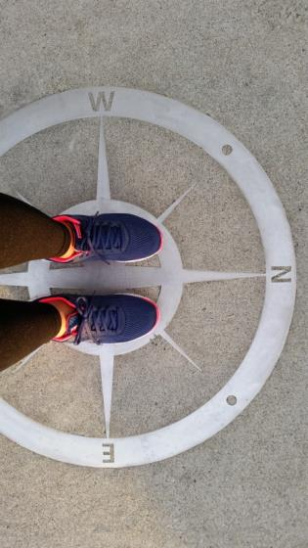
Our Focus
1
Shocking statistics
Impact of grief and emotions
Three stages of widowhood
Advice for new widows
Connect—best practices
Assisting widows
Research on widows and money
Shocking statistics
2
Impact of grief and emotions
3
Three stages of widowhood
4
Advice for new widows
5
Connect—best practices
6
Assist widows through your speaking and writing
7
Research about widows and money
For Professional Use Only. Not For Use With Consumers.
For Professional Use Only. Not For Use With Consumers.

Slide 7
The Shocking Statistics
TRUE OR FALSE:
There are about 12 million widows in the U.S., with approximately 1 million added each year.
TRUE OR FALSE:
There are about 12 million widows in the U.S., with approximately 1 million added each year.
The average age a wife becomes a widow is: (select one) 59, 65, or 71?
The average age a wife becomes a widow is: (select one) 59, 65, or 71?
Half of women over age 65 live ___ more years after their husband dies.
Half of women over age 65 live ___ more years after their husband dies.
?
?
TRUE OR FALSE:
70% of Baby Boomer wives will outlive their husbands; 80% of women will be single at death.
TRUE OR FALSE:
70% of Baby Boomer wives will outlive their husbands; 80% of women will be single at death.
?
?
?
?
On average, only ___% of widows aged 55-64 remarry; by age 65, only ___% remarry;
conversely a widower typically remarries within two or three years of his wife’s death.
On average, only ___% of widows aged 55-64 remarry; by age 65, only ___% remarry;
conversely a widower typically remarries within two or three years of his wife’s death.
TRUE OR FALSE:
Widowed female seniors outnumber widowed males by more than 4 to 1.
TRUE OR FALSE:
Widowed female seniors outnumber widowed males by more than 4 to 1.
TRUE OR FALSE:
Widows feel less secure about financial matters after the death of their spouse.
For Professional Use Only. Not For Use With Consumers.

Slide 8
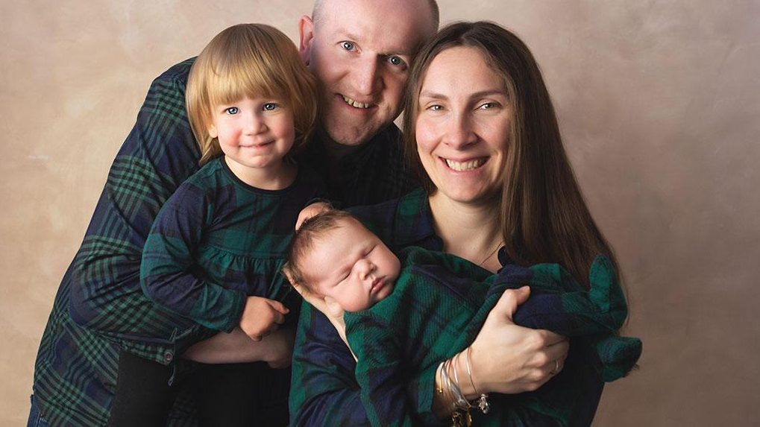
Coronavirus Widows
More men than women have died from Covid-19

Slide 9
80%
of men
80%
of women
die married
die single
For Professional Use Only. Not For Use With Consumers.

Slide 10

70%
of wives will be widowed
For Professional Use Only. Not For Use With Consumers.

Slide 11
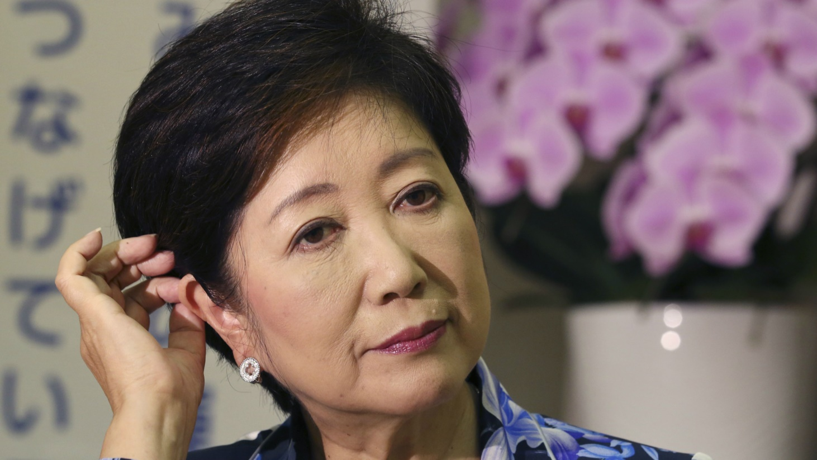
70%
of widows fire
the couple’s advisor after their spouse dies
For Professional Use Only. Not For Use With Consumers.

Slide 12

Why?
For Financial Professional Use Only. Not For Use With Consumers.

Slide 13

70%
of inherited trillions will go to women
For Financial Professional Use Only. Not For Use With Consumers.

Slide 14

Numb
Helpless
overwhelmed
Frightened
lonely
Angry
LOST
Guilty
Pained
Emotionally drained
DISCONNECTED
Forgetful
weak
Paralyzed
Vulnerable
abandoned
Fragile
relieved
disoriented
Aimless
“My husband’s death was the _most traumatic event in my life.”
-Claire
For Professional Use Only. Not For Use With Consumers.

Slide 15

Stress
and her brain
For Financial Professional Use Only. Not For Use With Consumers.

Slide 16

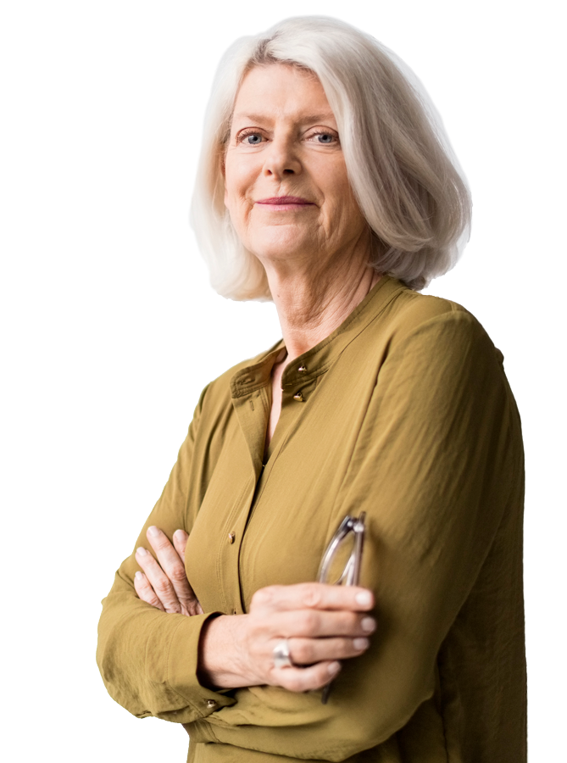
What she wants from you
For Professional Use Only. Not For Use With Consumers.

Slide 17




3 Stages of Widowhood©
Taking care of me
Taking care of business
Taking care of more
1. GRIEF/Numb
2. GROWTH/Journey
3. GRACE/Transformation
Financial Triage
Need to be heard and understood
General Planning
Cognitive functions normalized
Advanced Planning
New life evolves
Highly vulnerable time
NO big irrevocable decisions
Focus on immediate needs, settle estate, cash flow and asset review, file for benefits
“Financial Steps” done
Basic estate planning, investments and taxes
Pre or post-retirement issues and house decisions
Repurposing; independence
Advanced estate and charitable planning
Special family issues
Sharing letters, stories, values & aspirations for future generations
Breathe
Balance
Fulfillment
Feel Financially Secure
Source: Kathleen M. Rehl, Ph.D., CFP®, CeFT® Emeritus, author of Moving Forward on Your Own: A Financial Guidebook for Widows

Slide 18

Family problems?
How to settle the estate?
He always handled the money. I feel lost!
Will I be ok financially?
They don’t understand!
How much can I spend now?
How to handle investments?
We never talked about what to do after one of us died!
This is the worst I’ve ever felt.
What to do with life insurance money?
Should I move or stay?
_______
What to do with his car.
________
_________
For Professional Use Only. Not For Use With Consumers.

Slide 19
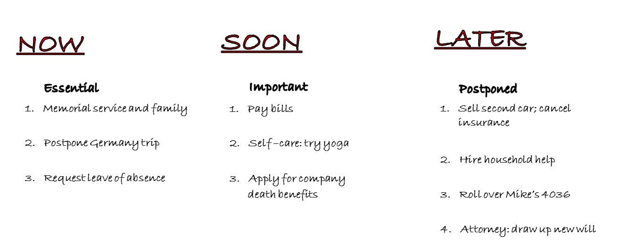

NOW
SOON
LATER
Essential
Important
Postponed
1. Memorial service and family
1. Pay bills
1. Sell second car; cancel insurance
2. Postpone Germany trip
2. Self –care: try yoga
2. Hire household help
3. Request leave of absence
3. Apply for company death benefits
3. Roll over Mike’s 4036
(b)
4. Attorney: draw up new will
For Professional Use Only. Not For Use With Consumers.

Slide 20






Advice for New Widows
For Professional Use Only. Not For Use With Consumers.

Slide 21


Connect!
1
Listen more, talk less
2
Help her feel secure and safe
3
Encourage taking time—DFZ
4
Avoid clichés
5
Be her “thinking partner”
6
Show compassion and care
For Professional Use Only. Not For Use With Consumers.

Slide 22


COMMUNICATION
JARGON
EFFICIENCY
For Professional Use Only. Not For Use With Consumers.

Slide 23

Craft Your Tagline
For Professional Use Only. Not For Use With Consumers.

Slide 24

For Professional Use Only. Not For Use With Consumers.

Slide 25

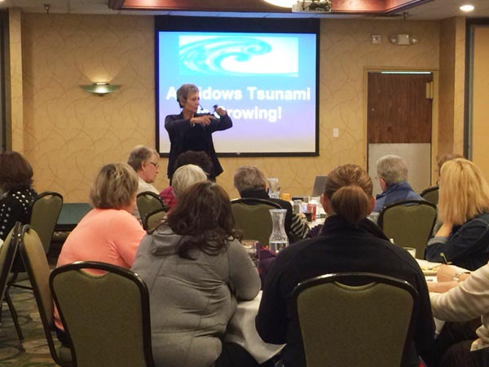
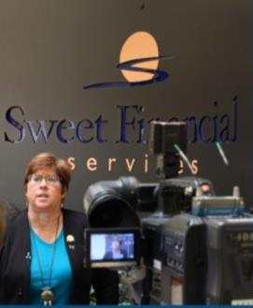

Speak & Engage!
For Professional Use Only. Not For Use With Consumers.

Slide 26

Wine and Chocolate Tasting
EVENTS
For Professional Use Only. Not For Use With Consumers.

Slide 27

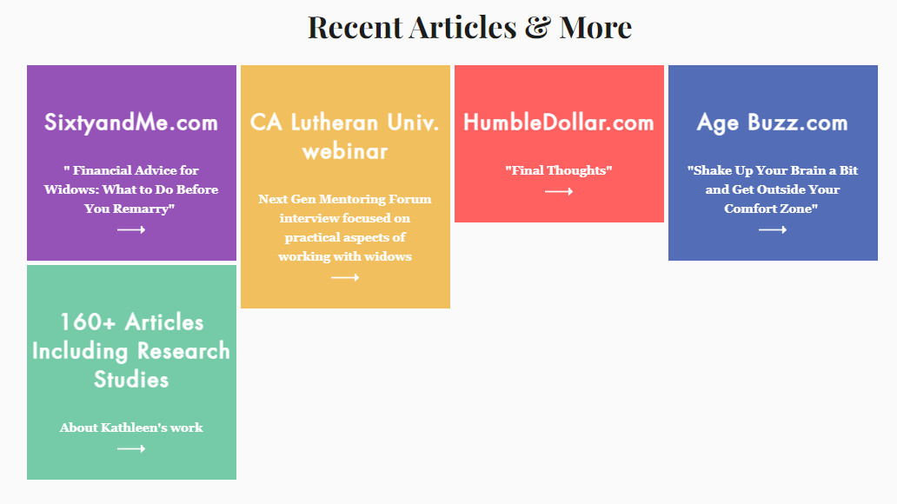
Write

Slide 28
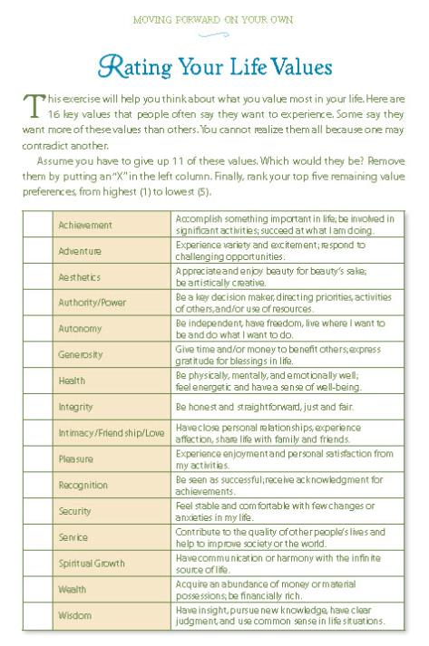

Your Gift…
“When the time is right.”
TOOLS
For Professional Use Only. Not For Use With Consumers.

Slide 29
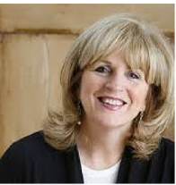
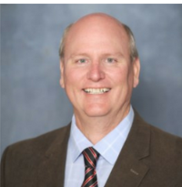
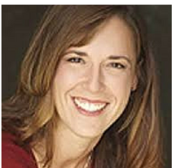
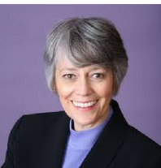
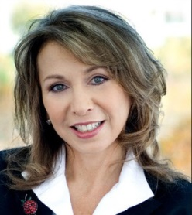
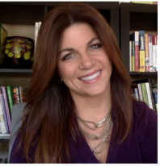
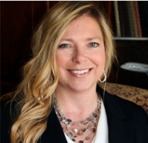
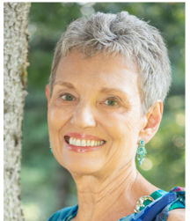
Research Team
Susan Bradley
CFP, CeFT
John E. Grable
PhD, CFP
Michele
Neff Hernandez
Linda Y. Leitz
PhD, CFP, CDFA
Laura Mattia PhD, CFP
Carolyn
C. Moor
Carrie L. West
PhD
Kathleen M. Rehl
PhD, CFP, CeFT Emeritus
For Financial Professional Use Only. Not For Use With Consumers.

Slide 30
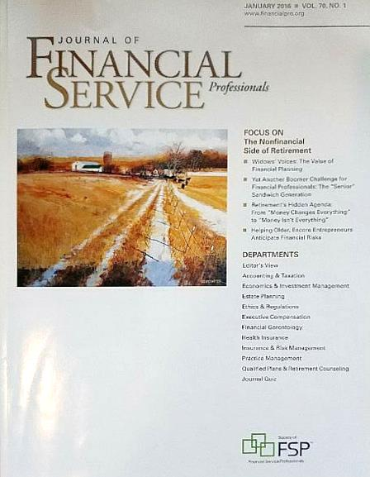
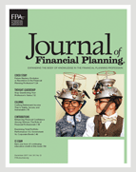
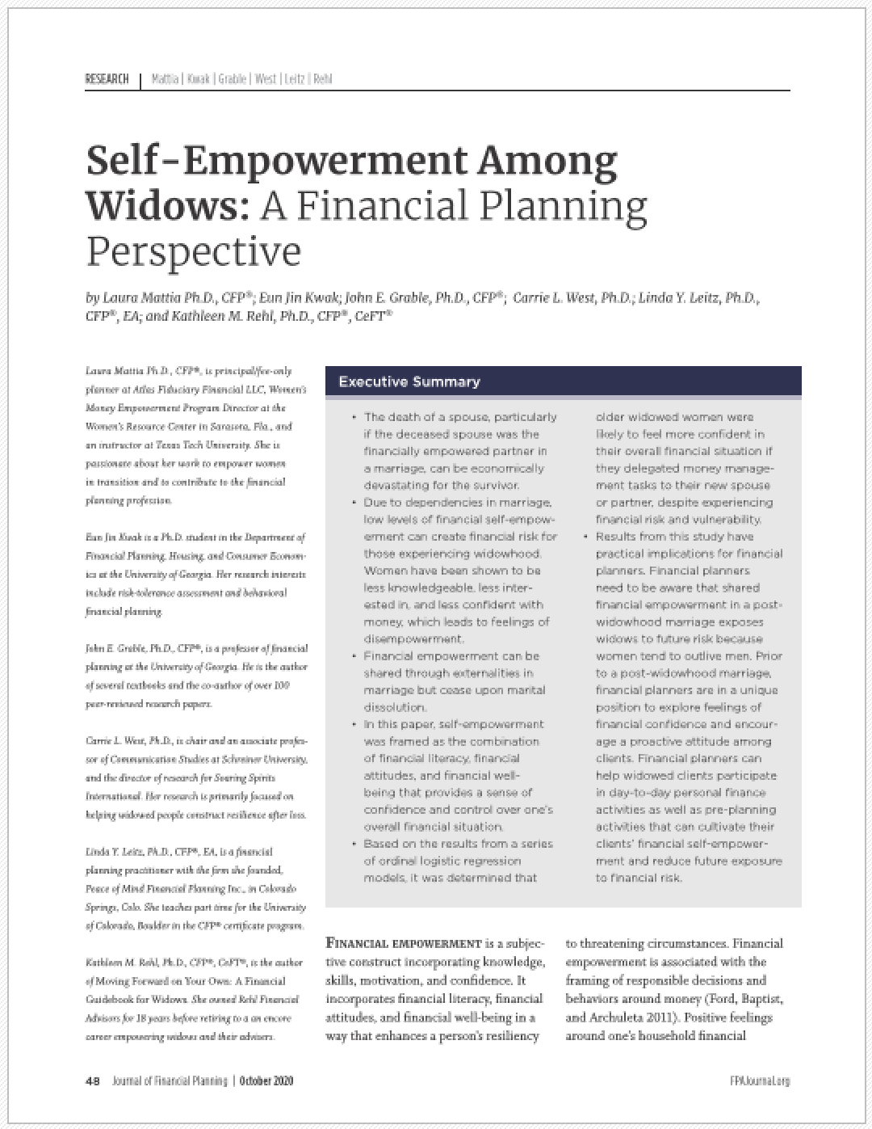

“Widows Voices: The Value of Financial Planning”
“Helping Repartnered Widows Navigate Romance and Finance: The Role of Financial Advice”
“Enhancing Financial Confidence Among Widows: The Role of Financial Professionals”
“Self-Empowerment Among Widows: A Financial Planning Perspective”
30
For Professional Use Only. Not For Use With Consumers.

Slide 31

Skilled financial planners—using empathy and communication skills—were almost twice as effective compared to less-skilled
professionals
For Professional Use Only. Not For Use With Consumers.

Slide 32


For Professional Use Only. Not For Use With Consumers.

Slide 33

She has loved.
She has lost.
But she can move forward on her own.
With your help, she isn’t alone.
For Professional Use Only. Not For Use With Consumers.

Slide 34
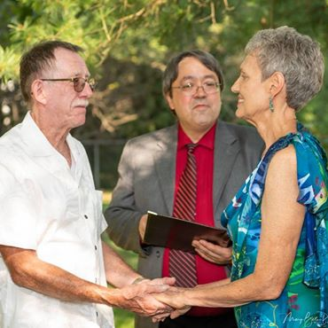

For Professional Use Only. Not For Use With Consumers.

Slide 35

Do.One.Thing.
For Professional Use Only. Not For Use With Consumers.

Slide 36

Possible Action Steps
Stop saying “I’m so sorry for your loss.”
Use a new tool
Give the guidebook
Craft your story
Design a tagline
For Professional Use Only. Not For Use With Consumers.

Slide 37

“Do well by doing good.”
– Benjamin Franklin
For Professional Use Only. Not For Use With Consumers.

Slide 38
THANK YOU!
Kathleen@KathleenRehl.com
www.KathleenRehl.com
For Professional Use Only. Not For Use With Consumers.

